Slide 1

What Women Respond To
In Video Games
By Vidya Gaddy
Notes:
Hello, this is a presentation reviewing some research and data related to what women want in video games. These materials were collected to construct a foundation for a semester long project I'm working on to design a game intended to encourage more women to get involved in computer science.

Slide 2

Topics
Psychological effects of stereotypical female portrayals in video games
  Vastly researched
Most popular game genres among women
  Why?
Least popular game genres among women
  Why?
What / how women learn from video games
Notes:
Since deciphering what women respond to is such a vast subject I figured it would be best to break down my search into the topics listed

Slide 3
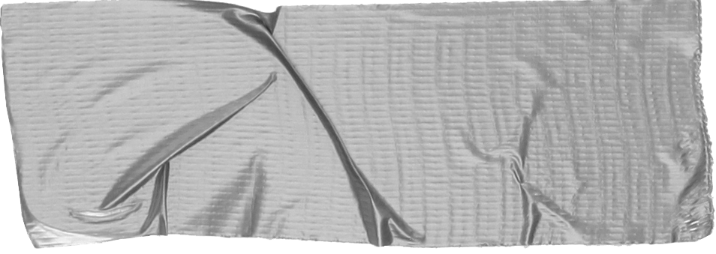

Representation of Women in Video Games:
A Systematic Review of Literature in Consideration of Adult Female Wellbeing
Meghan Gestos, BBS(Psych), Jennifer Smith-Merry, PhD, and Andrew Campbell, PhD: CYBERPSYCHOLOGY, BEHAVIOR, AND SOCIAL NETWORKING: Volume 21, #9 (2018)
Background
22 Peer Reviewed Publications
3 Themes:
  Female characters’ underrepresentation and sexual objectification
  Attitudes toward women
  Female self-objectification and body image
Notes:
The first topic, the effects of stereotypical female portrayals in video games, is widely researched in psychology so it was an obvious starting point. This literature review, name, was published just last year and was interested in several themes that could absolutely impact the expectations of women when it comes to gaming. The themes I found most intriguing for my research on here were under representation and objectification

Slide 4


Conclusions
Sexual objectification of female video game
characters lowers self-esteem and self-efficacy
of female video game players
Very few nonsexualized female characters leaves women disinterested in many video games
Relevance
Use a plethora of female characters in this game
Make sure all female characters are respected and
admired
Idea: Female omniscient guide through the game >>>
Notes:
The results of this study were largely what you would expect. Under representation of realistic female characters leaves real women feeling excluded from the video game community. And those who do find themselves in the community run the risk of lowering their own self-esteem and self-efficacy by being largely exposed to female characters who need others to progress and who don’t have realistic bodies. In response to these finding I have every intention of filling this game with many female characters of all shapes, sizes and backgrounds. I also wanted to explore the idea of having the guide through the game be something like Eve for Wall-E, her voice and vibe are indicative of being a female but she has no distinguishing female features that a woman playing can desire for themselves.

Slide 5


Games Women Want
vs.
Games Women Hate
Notes:
Next I want to touch on real game data that has been collected to determine what kinds of games women are playing and what games they tend to avoid and why

Slide 6
Quantic Foundry
Founders: Nick Yee, PhD, Nicolas Ducheneaut, PhD
Website
  https://quanticfoundry.com/#motivation-model
About
  Conduct surveys and publish articles about the data they collect concerning gaming motivation
Relevance
  Often focus on the impacts of age and gender
Notes:
Quantic foundry is a website created by two Berkley PhD graduates designed to collect and interpret data on gaming motivation. They have published several articles specific to women’s preferred genres and why, produced as recently as 2017

Slide 7
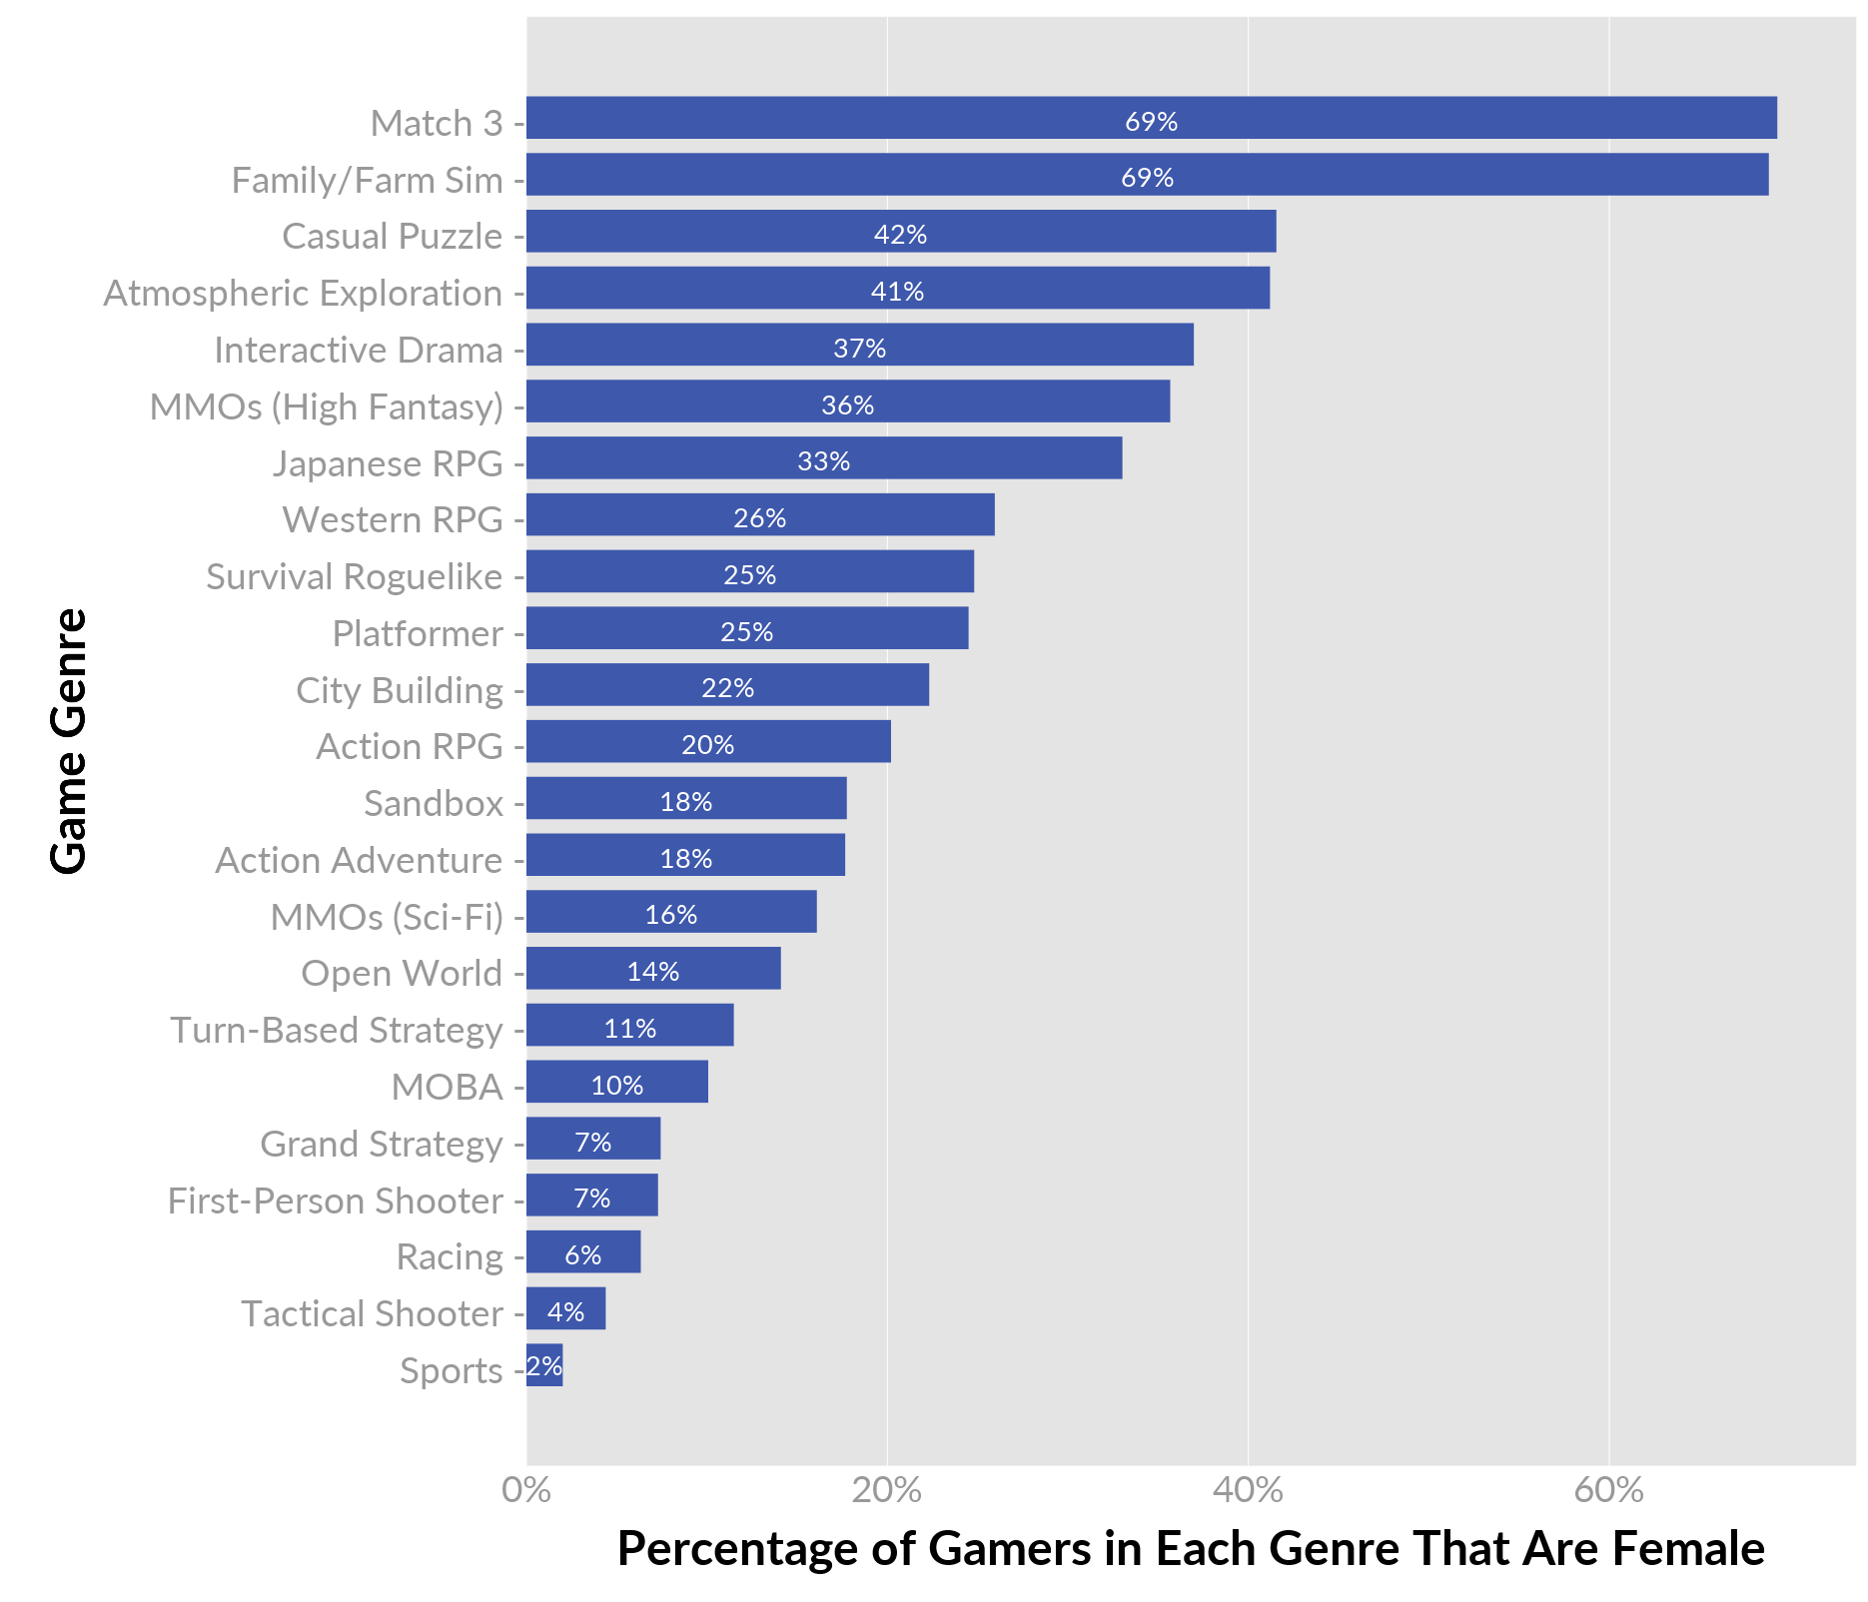
The Results Are In
270,000 gamers surveyed
Picked popular game exemplars to determine genres
MATCH 3 (69%) and Family / Farm Simulation (69%) are 27% above any other genre
Sports Games (2%), Tactical Shooters(4%), and Racing games (5%) came in last place
https://quanticfoundry.com/2017/01/19/female-gamers-by-genre/
Notes:
Surveying around 270,000 participants 18% of which identified as female, they found that women strongly preferred Match 3 and Simulation games to most other games. Sports, Shooters, and Racing games were last on the list. The authors believed quote:
Talk about Dragon Age: Inquisition, Star Wars, WoW,
●“Games on the bottom of the chart tend to not have female protagonists , tend to involve playing with strangers online, and tend to have a lot of rapid 3D movement which can lead to motion sickness.” (https://quanticfoundry.com/2017/01/19/female-gamers-by-genre/) https://www.ncbi.nlm.nih.gov/pubmed/16018346
The first suggestion the authors made ties back to the literature review. And more often than not online communities can be toxic environments.

Slide 8
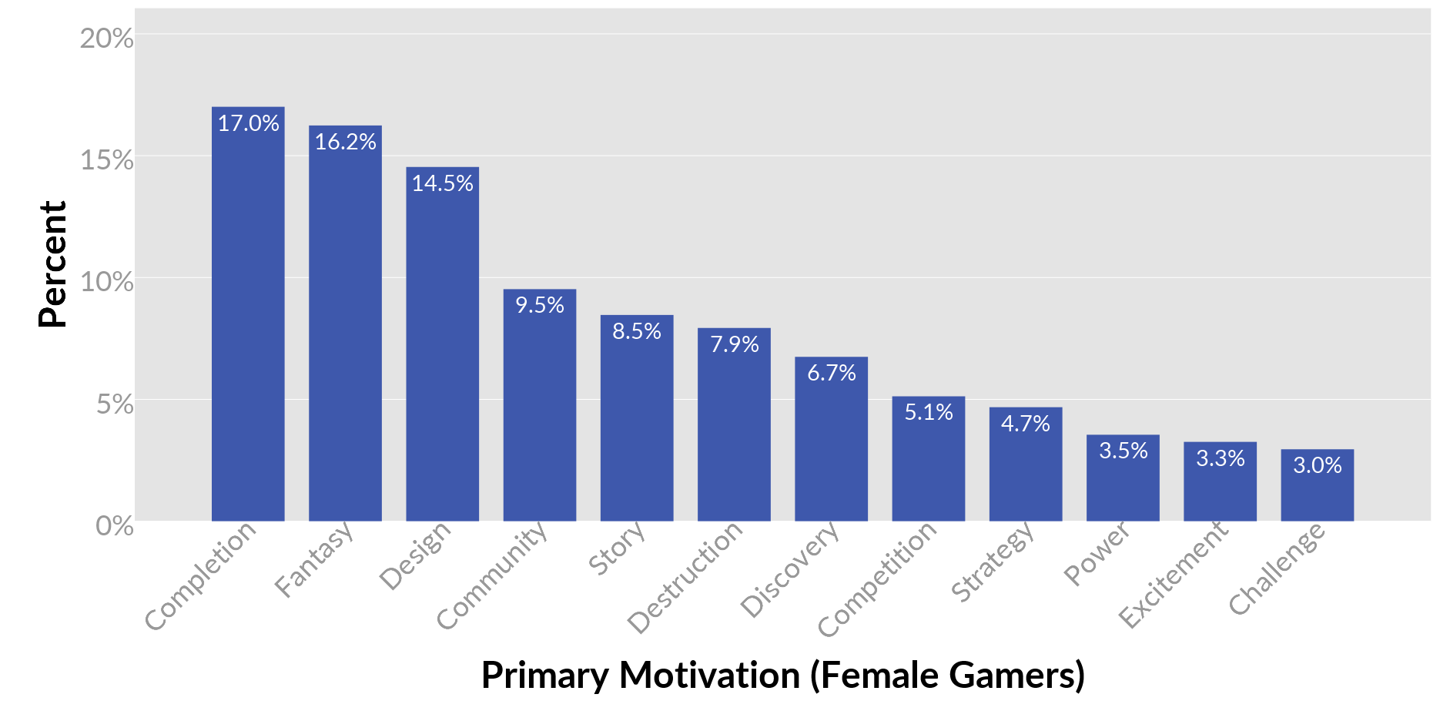
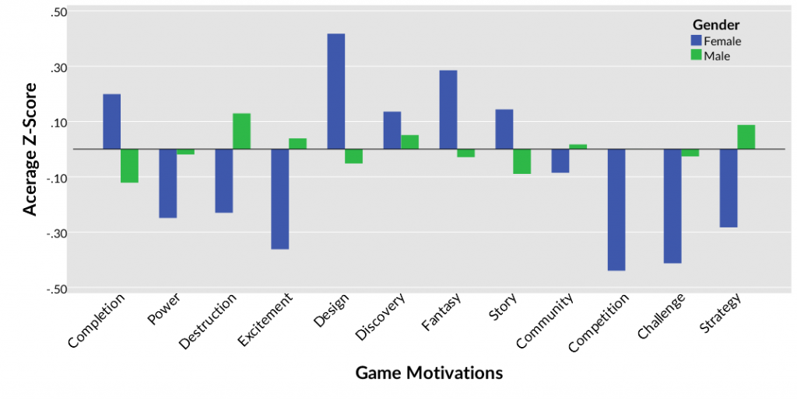
Here’s Why
Completion, Fantasy, and Design make up 47% of all motivation for women
Completion ranked in the top 3 motivations across gender and age
  Low-Risk / High Reward
https://quanticfoundry.com/2016/12/15/primary-motivations/
Notes:
In another article analysing gamer motivation they discovered that women are most motivated to play games because they enjoy completion, fantasy and design. Again women favor these motivation far more than the others. The distribution of this data suggests to me that women really enjoy what they enjoy and may be being forced to ignore everything else because they are being excluded by those communities.

Slide 9

The Effectiveness of Casual Games in Improving Mood and Decreasing Stress
Carmen V. Russoniello, Kevin O’Brien and Jennifer M. Parks
Journal of CyberTherapy & Rehabilitation Spring 2009, Volume 2, Issue 1 © Virtual Reality Medical Institute
143 college aged participants, over half being female
Measured participants brain waves while playing casual games (Bejeweled 2, Bookworm Adventures, Peggle)
Result: Casual games do improve mood and reduce stress
What About Casual Games
Notes:
Since match 3 gaming was so high on the list of games women enjoyed I undertook looking for information on why specifically women may prefer that kind of came. This study actually went in and measured participants brain waves while playing casual games like match 3 games. They targeted waves responsible for stress and mood and found that these games do in fact, neurologically decrease stress and improve mood. Women may favor these games because studies have shown that women tend to seek out help when anxious and stressed in the form of therapy more often than men, so it would make sense that they would utilize de-stressing tools more often as well.

Slide 10
Cognitive consequences of making computer-based learning activities more game-like
Krista E. DeLeeuw, Richard E. Mayer
Department of Psychology, University of California, Santa Barbara, United States 2011
Experiment
  137 college students (non-CS) participants
  Added game elements (scoring, incentive) to a circuitry learning tool called Circuit Game
Findings
  Women showed a significant improvement in learning when playing the game compared to using the learning tool
Notes:
The last study I want to share is this one concerning learning through games since learning is one important attribute of the game I hope to design. This study set out to determine if adding game features to a learning tool would result in higher encoding rates of the content in the learning tool. The learning tool was meant to teach people how circuitry works which is perfect, since my game would include similar content being of and related to computer science. The results of the study suggested that were men did not see a significant improvement in learning with game features added women did, which is very encouraging.

Slide 11

Game Design Ideas
Notes:
The game design idea I have that I’m most excited about is this one. The game could be called Puella Scientia (Girl Scientist in latin) and as you can see it would have a bright welcoming vibe. The idea behind the game is that the majority of the world’s population is gone and just a few machines were left to bring the earth back to a utopian state. But humanity must prevail. The player would be part of a team of women, engineers, chemists, physicists, and most importantly computer scientists who are given a task by the guide to rebuild humanity in a sustainable way.

Slide 12
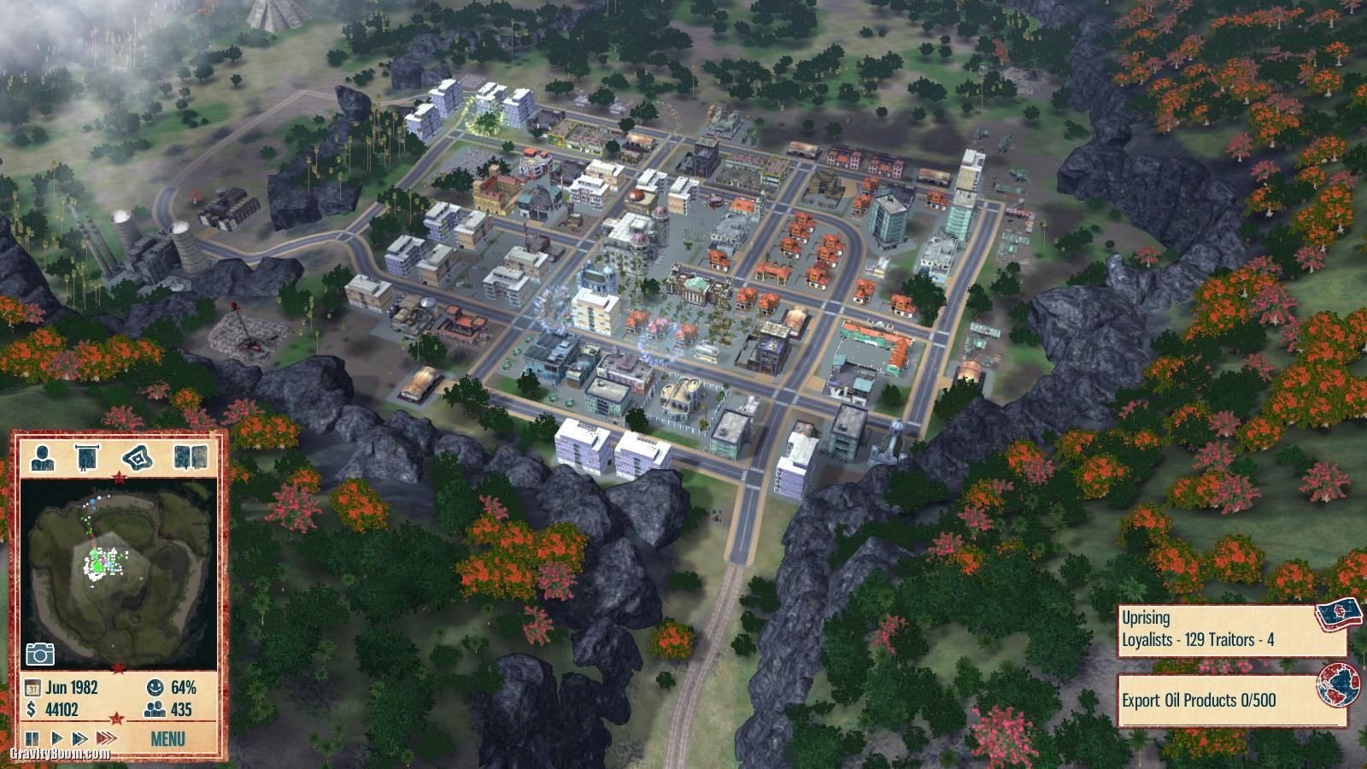
Game Design Ideas
Design and Completion elements
Great for simulation, puzzle, and casual gaming
Build using programming and engineering concepts
Alternatives
Puzzle Game set in classroom environment
Deserted Island survival puzzle game
Notes:
The game would include minigames much like match 3 and casual games which would subliminally teach players important CS concepts like search algorithms, binary, transistor flows, even functions and code all done to contribute to building structures like water filtration centers, stable nuclear power plants, and high efficiency solar panelled houses. Something like this would certainly encourage me to get involved in these STEM fields.
And if this idea isn’t appealing I was also considering puzzle games in a classroom environment, or a survival type of simulation puzzle game

Slide 13

Conclusions
Don’t objectify women, we don’t respond well to it
Women like to use video games as an escape, and method of de-stressing
Women seem to learn from video games more readily than men
Notes:
Anyway, in conclusion I have no intention of objectifying or under representing women in this game, and I will definitely include attributes focused on primary motivations among women playing video games no matter what game I end up designing. Thank you.

